Slide 1
INSTAGRAM USER ANALYTICS
Project by – AYUSH YADAV
TASKS:
A) Marketing:
1. Rewarding the Most Loyal Users: To find 5 oldest users of Instagram from the database provided
Query:

Slide 2
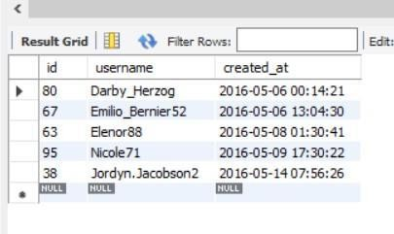
SELECT *
FROM users
ORDER BY created_at
LIMIT 5;
Conclusion: Users with id 80 ,67,63,95,38 are 5 oldest users of Instagram
2. Remind Inactive Users to Start Posting: To find users who have never posted a single photo on Instagram.
Query:
SELECT users.username AS Username , Photos.id
FROM users
LEFT JOIN photos ON users.id = photos.user_id
WHERE photos.id IS NULL;

Slide 3
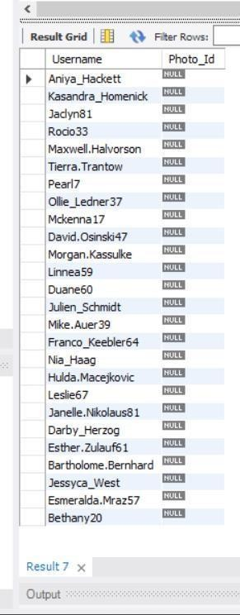
Conclusion: Above mentioned Users didn’t provide a single photo so photo_id is NULL.

Slide 4
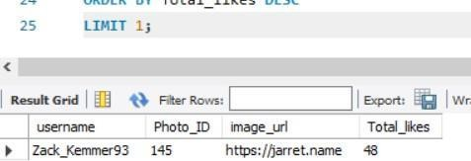
3. Declaring Contest Winner: To find which user got most likes on a single photo
Query:
SELECT
username,
photos.id AS Photo_ID, photos.image_url, COUNT(*) AS Total_likes FROM photos
INNER JOIN likes
ON likes.photo_id = photos.id
INNER JOIN users
ON photos.user_id = users.id
GROUP BY photos.id
ORDER BY Total_likes DESC
LIMIT 1;

Slide 5
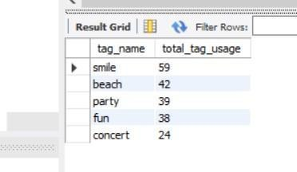
Conclusion: Photo_ID 145 is the photo got most likes posted by username Zack_Kemmer93.
4. Hashtag Researching: To identify and suggest Top 5 most commonly used tags on the platform.
Query:
SELECT tag_name,
COUNT(tag_name) AS total_tag_usage
FROM tags
INNER JOIN photo_tags ON tags.id = photo_tags.tag_id
GROUP BY tags.id
ORDER BY total_tag_usage DESC LIMIT 5;

Slide 6
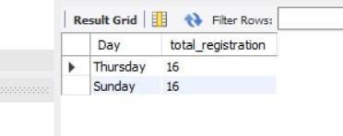
Conclusion : smile , beach , party , fun and concert are the most used hashtags on the platform.
5. Launch AD campaign: To find which day most user registers on the platform.
Query: SELECT dayname(created_at) AS Day , count(*) AS total_registration FROM users
GROUP BY Day
ORDER BY total_registration DESC LIMIT 2;
Conclusion: Most user registers on Thursday and Sunday.

Slide 7
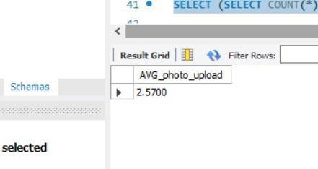
B) INVESTOR METRICS
1. User Engagement: To find how many time on avg user post photos and also to show total no of photos and total no . of users.
Query:
SELECT
(SELECT COUNT(*)FROM photos)/(SELECT COUNT(*)
FROM users) AS AVG_photo_upload;
Conclusion : Average photos uploaded by user is 2.5700.

Slide 8
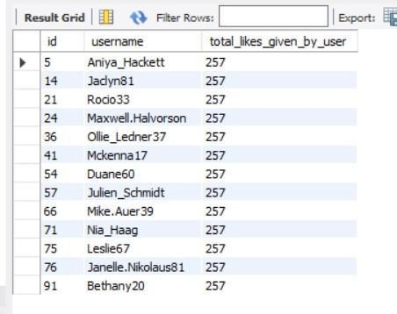
2. Bots & Fake account: To find the users who liked every photo.
Query:
SELECT users.id,username, COUNT(users.id) AS
total_likes_given_by_user
FROM users
INNER JOIN likes ON users.id = likes.user_id
GROUP BY users.id
HAVING total_likes_given_by_user = (SELECT COUNT(*) FROM photos);
Conclusion: All the above mentioned users liked every single photos.

